Slide 1
Image Captioning of Earth Observation Imagery MDS-MDA Joint Capstone Project
Dora Qian, Fanli Zhou, James Huang, Mike Chen
MDS Mentor: Varada Kolhatkar
MDA Partners: Andrew Westwell-Roper, Shun Chi
1

Slide 2
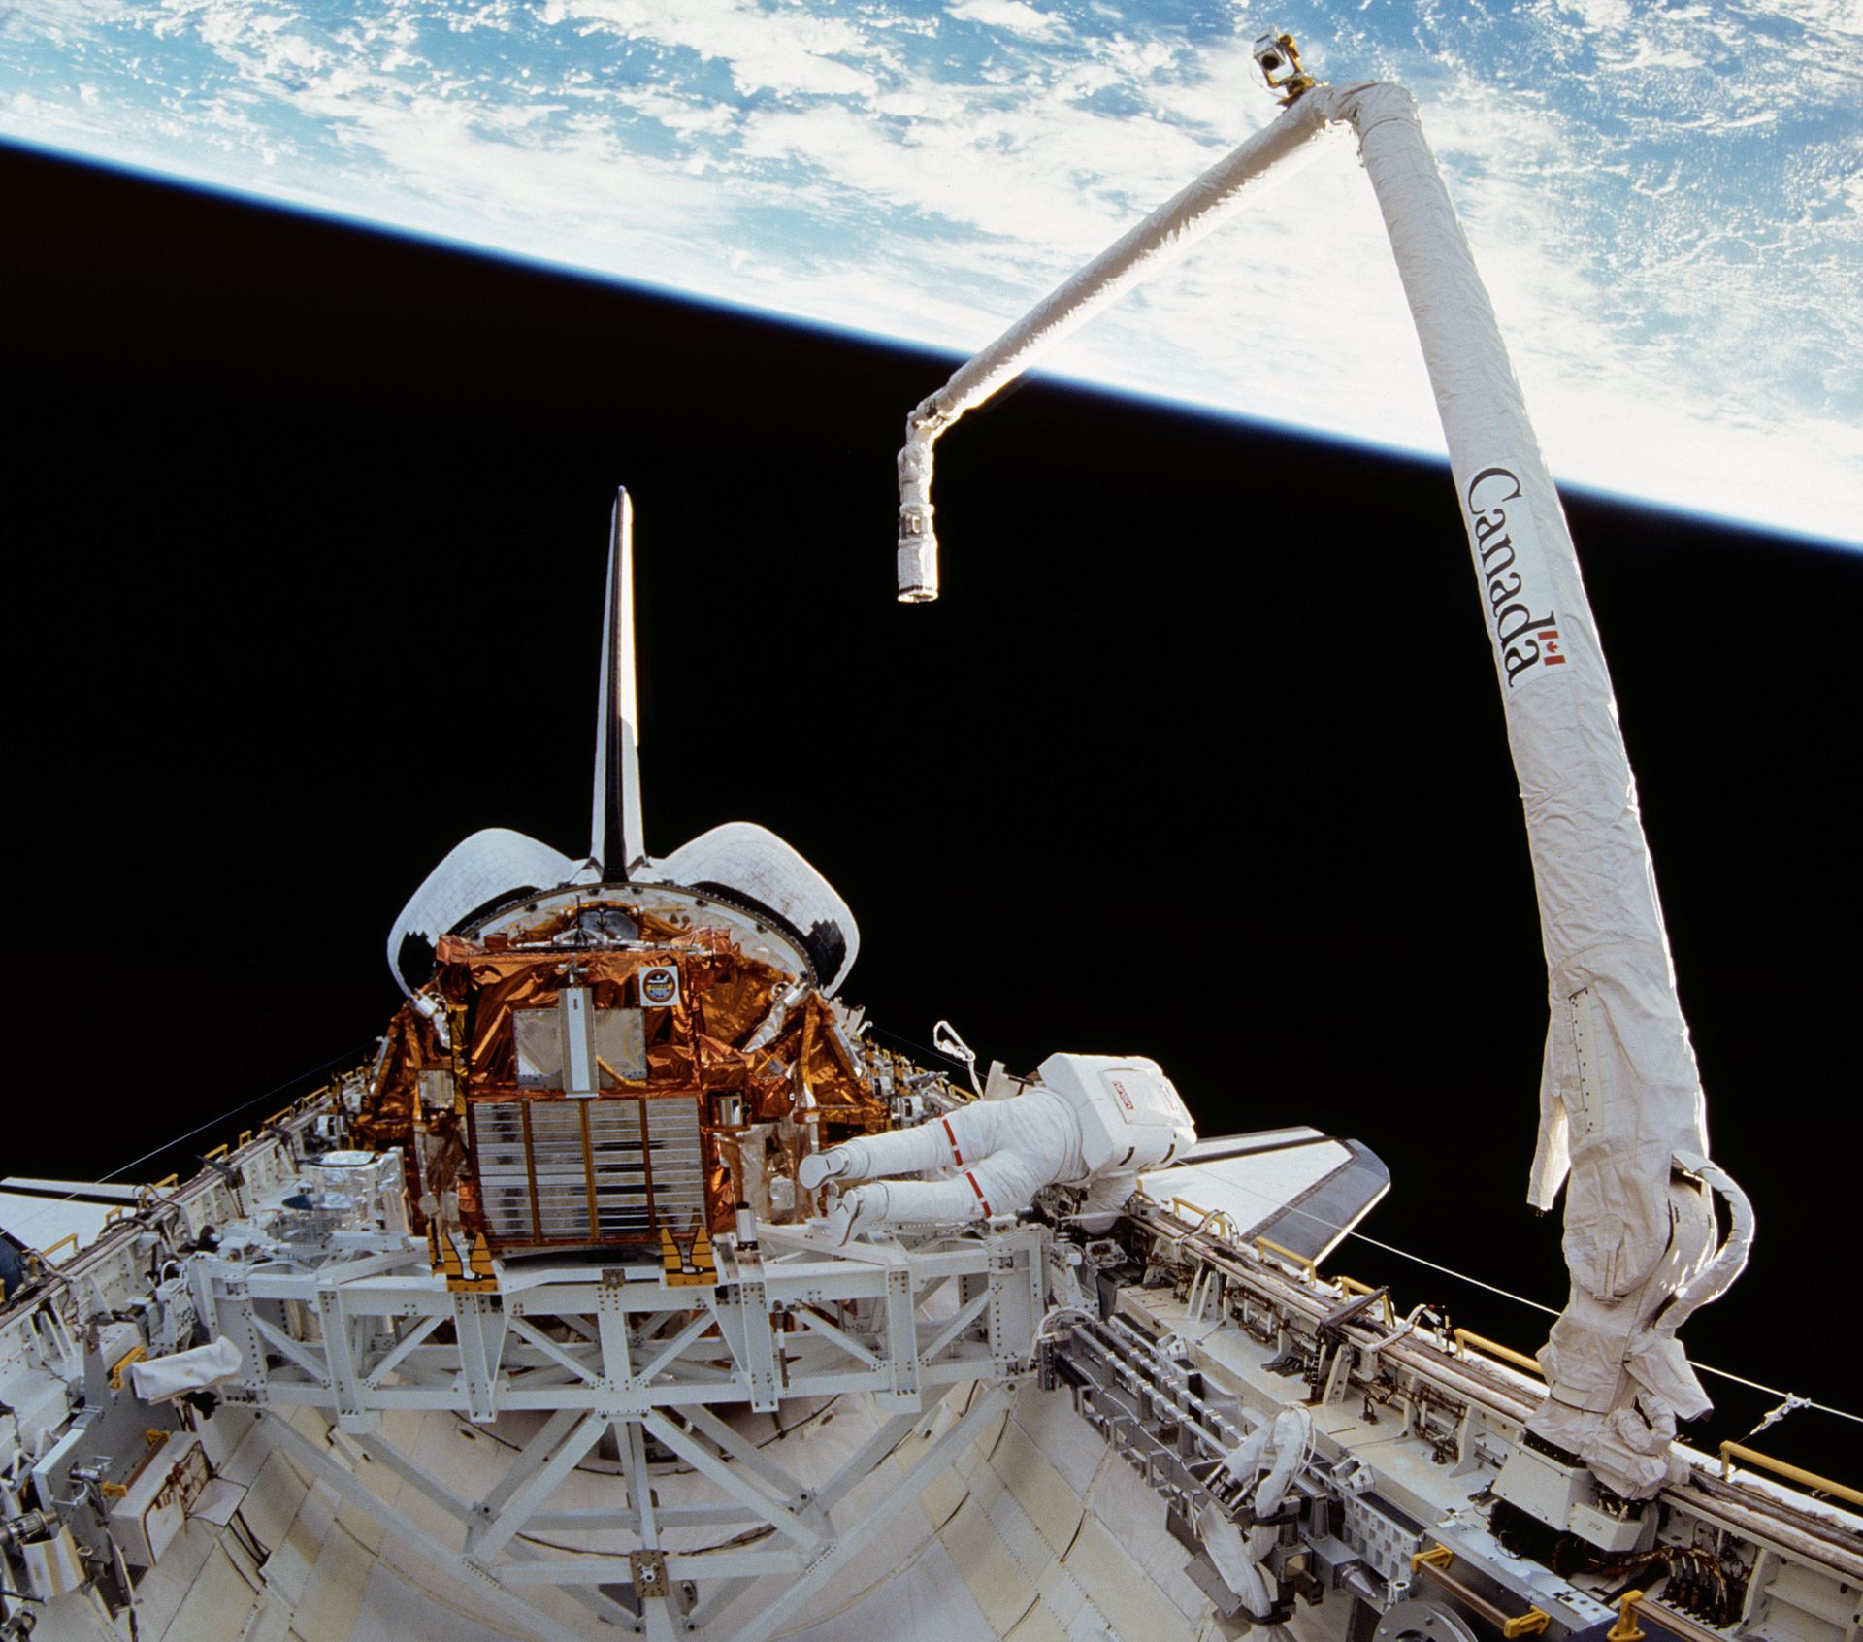
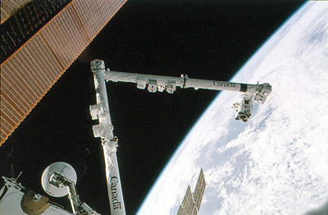
MDA
A Canadian aerospace company
Developed Canadarm and Canadarm2
Sources: Canadarm, Canadarm2

Slide 3
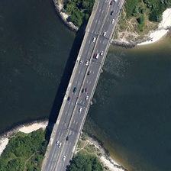
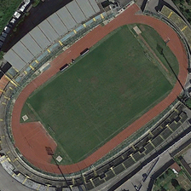
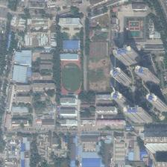
Data Science Problem and Motivation
Access to a vast database of uncaptioned satellite images
We aim to caption these images
Associating an image with a caption makes it accessible
Sort images based on content
Return queries
Evaluate similarity
Sources: Image adapted RSICD_optimal dataset

Slide 4
Overall Goal
Develop a pipeline
Given a set of labelled satellite images, develop an end-to-end image captioning system.
Create a visualization tool
Aim to help users interact with model and data

Slide 5
Specific Objectives
Data preprocessing
Transform and store data in a well-defined and reproducible structure
Model development
Extract features from image
Generate sentence from features
Model evaluation
Apply n-gram based and semantic similarity based evaluation metrics
Visualization
Generate captions for unseen user uploaded images, and upload results to the database
View previously generated image/caption pairs and evaluation scores

Slide 6
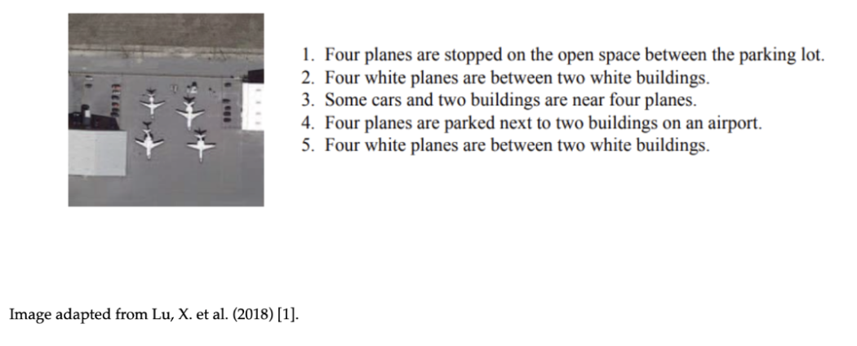
Data Description
There are three labeled datasets:
UCM_Captions
RSICD (Remote Sensing Imaging Captioning Dataset)
Sydney_Captions
Total 13,634 Images
Train/valid/test on UCM_Captions and RSICD
Test on Sydney_Captions for generalization ability
Sources: Image adapted from Lu, X. et al. (2018) [1]

Slide 7
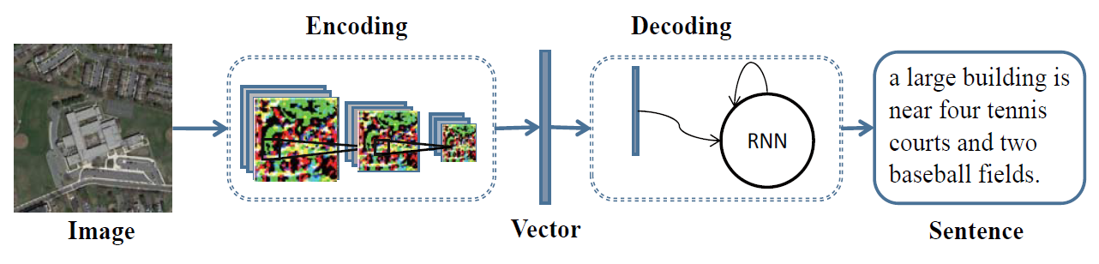
Baseline Model Architecture (CNN + LSTM)
Data Science Techniques
Sources: Image adapted from Lu, X. et al. (2018) [2]

Slide 8
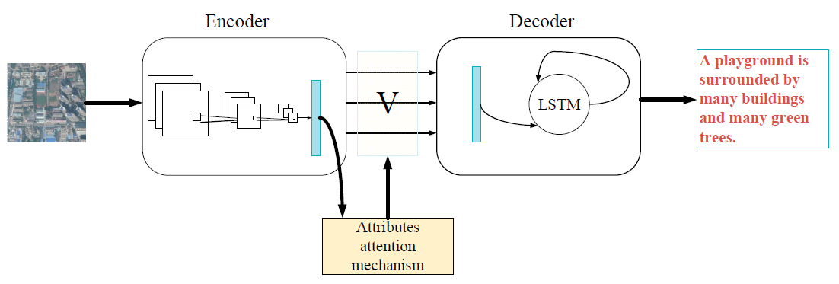
Attention Model Architecture (CNN + Attention + LSTM)
Data Science Techniques
Sources: Image adapted from Zhang, X. et al. (2019) [3]

Slide 9
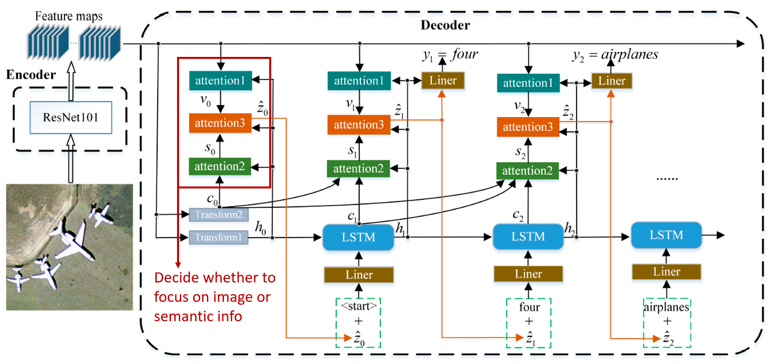
Multi Attention Model Architecture (CNN + Multi-Attention+ LSTM)
Data Science Techniques
Sources: Image adapted from Li, Y. et al. (2020) [4]

Slide 10
Data Science Techniques: Transfer Learning
Pre-trained CNN:
InceptionV3
Vgg16
…
Pre-trained embeddings weights :
GloVe (200d)
Wikipedia2Vec (500d)
Pros:
Good performance
Simple to incorporate
Reduces training time
…
Cons:
Performance depends on task similarity
…

Slide 11
Data Science Techniques: Evaluation Metrics
Total 9 evaluation metrics
N-gram based metrics
Bleu 1-4
Rouge L
Meteor
CIDEr
Commonly used in the community and research papers
Problem with N-gram based metrics

Slide 12
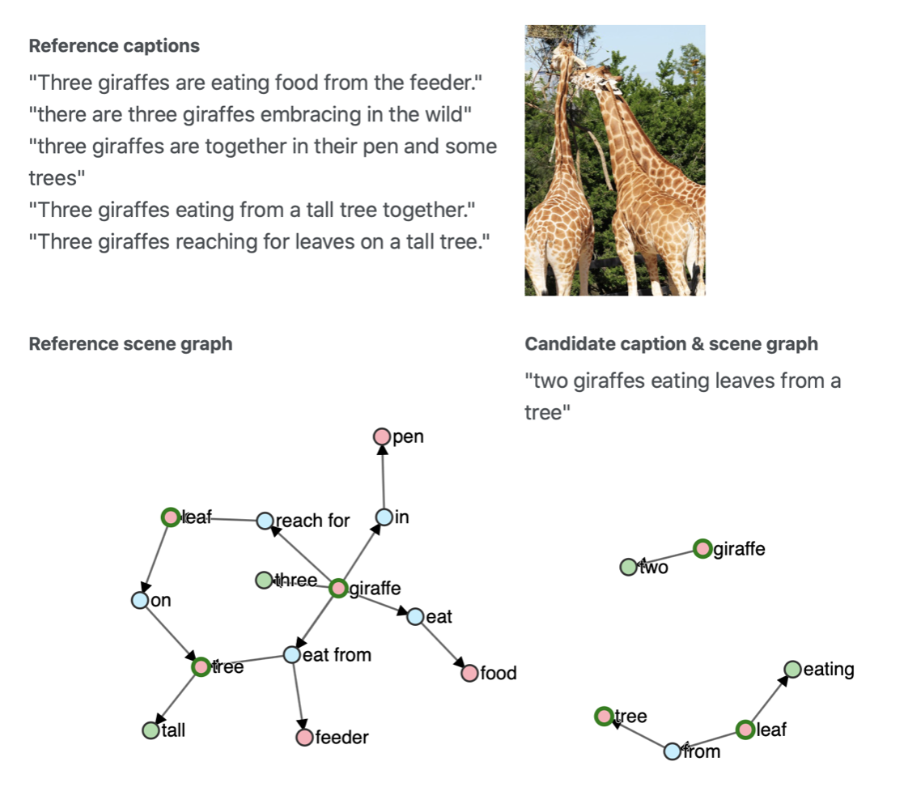
Data Science Techniques: Evaluation Metrics
Semantic-based metrics:
Universal Sentence Encoder Similarity
SPICE: semantic scene graph
N-gram based metrics:
BLEU-1 score = 0.74
BLEU-2 score = 0.46
BLEU-3 score = 0
BLEU-4 score = 0
Semantic based metric:
SPICE score = 0.3

Slide 13
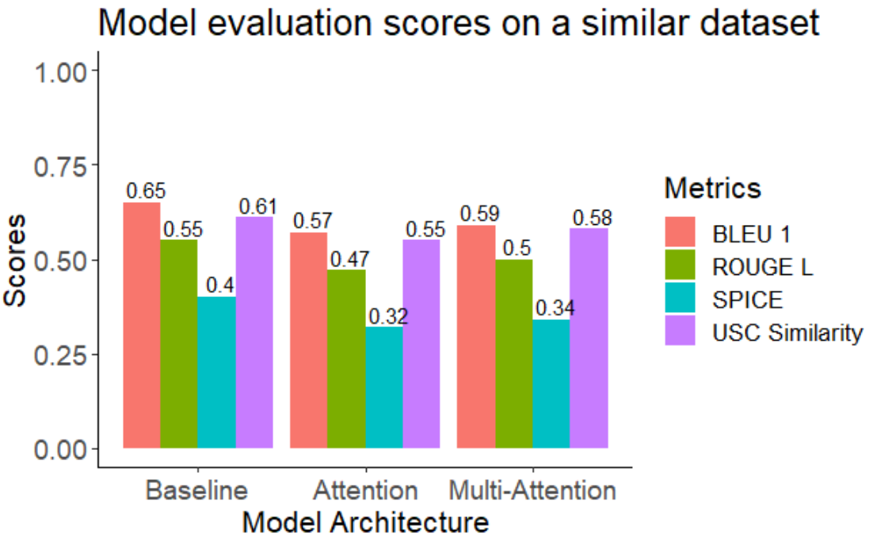
The Baseline Model Shows The Best Performance
Test data and train data are from the same datasets
BLEU 1 and ROUGE L scores range from 0.5 to 0.8 on the baseline in literatures

Slide 14
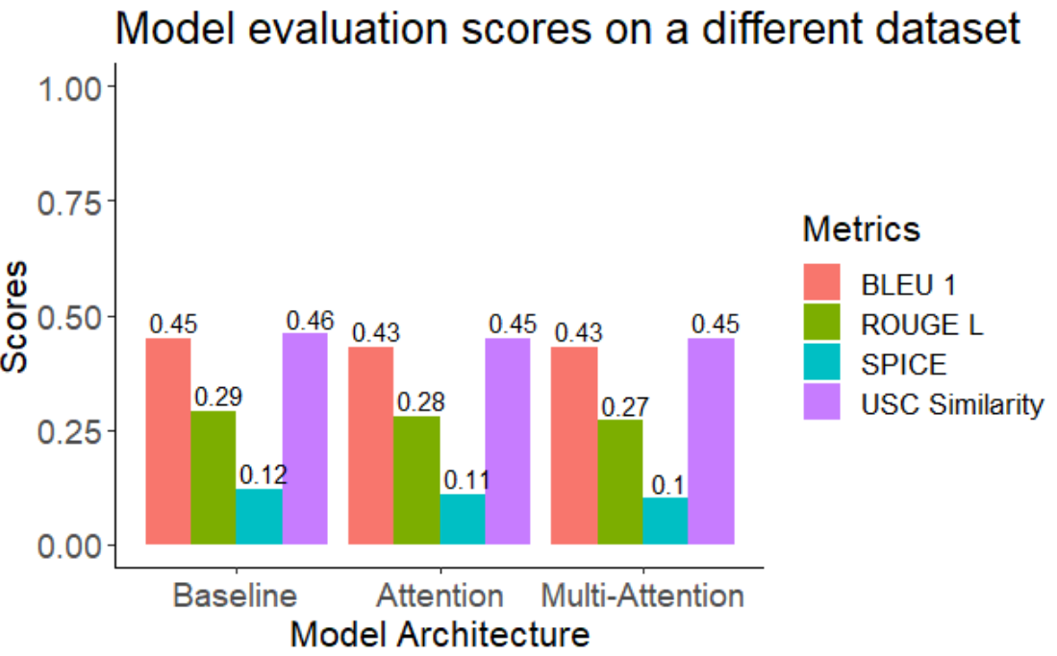
Models Show Poor Generalization Capabilities
Test data and train data are from the different datasets

Slide 15
Other considerations
CNN models learned from scratch
Embeddings learned from scratch

Slide 16
Future Improvements
Optimizing hyperparameters
Finetuning the pre-trained CNN
Extracting features from different convolutional layers
Improving attention structures

Slide 17
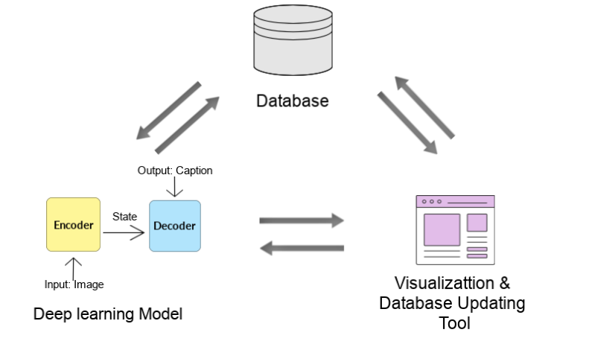
Final Data Product
Complete image captioning pipeline
3 independent modules

Slide 18
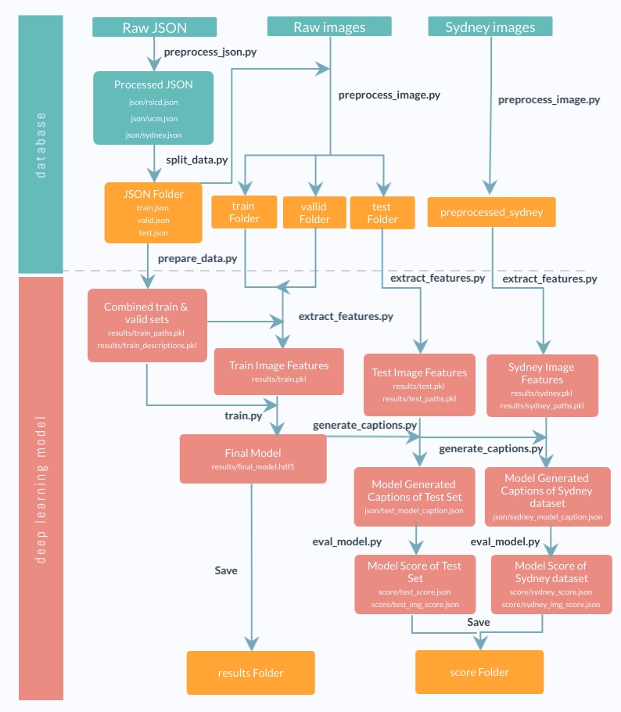

Product Pipeline
Database & Model: GNU Make
Visualization tool: Django

Slide 19
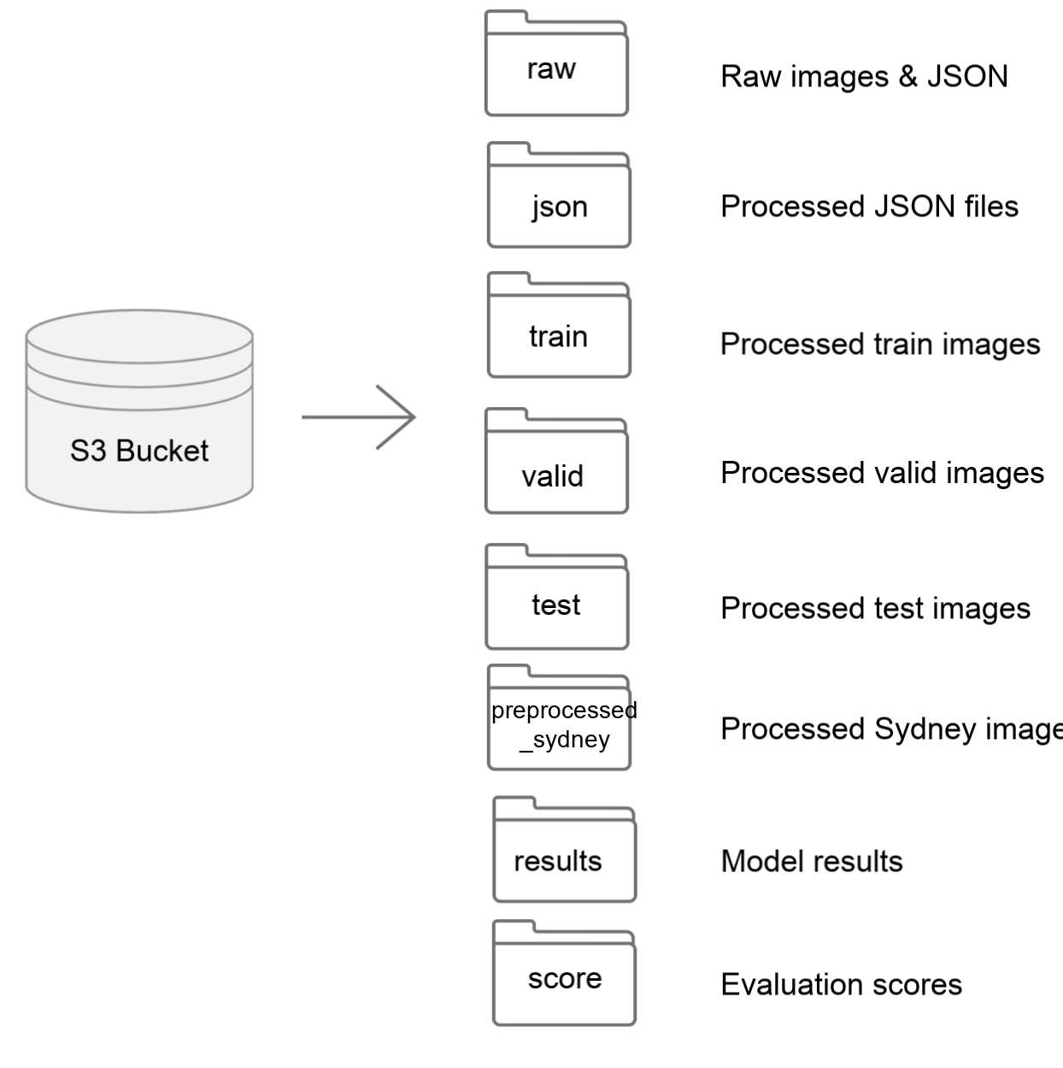
Final Data Product: Database
AWS S3 bucket
Advantages:
- Integrate well with AWS instance
- Scalability
- Easy to use

Slide 20


Final Data Product: Deep Learning Model
AWS EC2 P3 instance
Final model: Baseline model with VGG 16 & Glove Embedding
Train
Generate Caption
Evaluate
Save trained model, model results and score back to database
Sources: AWS logo, Pytorch logo

Slide 21
Client’s Needs
Final Data Product: Visualization Tool
A visualization tool capable of:
Generate caption for new uploaded images
Allow users to submit their own captions for the image
Showcase the evaluation metrics
Allow users to upload multiple images with a json caption file

Slide 22





Final Data Product: Visualization Tool
Front End
HTML, CSS, JavaScript
Back End
Django - Python based web framework
Database
AWS S3: To store all the images and caption json file
Sources: HTML logo, CSS logo, Javascript logo , django logo, S3 logo

Slide 23
Visualization Tool Showcasing
Demo for showcasing
Insert screenshot for submission later

Slide 24
Conclusion
We have been successful in creating a functional data pipeline and visualization tool
Our goals were met and all the features we aimed to create are available
Performance of the model is fair
We hope that MDA can iterate and improve upon our work

Slide 25
Limitations
Relatively small dataset
Poor performance of CNN feature extraction models trained from scratch
Using pre-trained model trained on ImageNet type images
Attention model did not perform as expected
The captions were not significantly improved and was at times worse
Short project time
Lacked time to add or fine tune more layers

Slide 26
Recommendations
Explore training a CNN feature extraction model from scratch
Use much larger captioned satellite image datasets found online
Fix or refine attention model
A well implemented attention model should yield better results
Add or fine tune model layers
More comprehensive cross-dataset performance evaluation

Slide 27
References
1. B. Qu, X. Li, D. Tao, and X. Lu, “Deep semantic understanding of high resolution remote sensing image,” International Conference on Computer, Information and Telecommunication Systems, pp. 124–128, 2016
2. Lu, X.; Wang, B.; Zheng, X.; Li, X. Exploring models and data for remote sensing image caption generation. IEEE Trans. Geosci. Remote Sens. 2018, 56, 2183–2195
3. Zhang, X.; Wang, X.; Tang, X.; Zhou, H.; Li, C. Description Generation for Remote Sensing Images Using Attribute Attention Mechanism. Remote Sens. 2019, 11, 612
4. Li, Y.; Fang, S.; Jiao, L.; Liu, R.; Shang, R. A Multi-Level Attention Model for Remote Sensing Image Captions. Remote Sens. 2020, 12, 939
5. SPICE: Semantic Propositional Image Caption Evaluation. Peter Anderson, Basura Fernando, Mark Johnson and Stephen Gould. In Proceedings of the European Conference on Computer Vision (ECCV), Amsterdam, the Netherlands, October 2016.

Slide 28
Thank you
Questions?

